Slide 1
Introduction
What is OpenMP
Open specifications for Multi Processing
Long version: Open specifications for MultiProcessing via collaborative work between interested parties from the hardware and software industry, government and academia.
OpenMP (Open Multi-Processing) is an application programming interface (API) that supports multi-platform shared memory multiprocessing programming in C, C++, and Fortran.
API components:
– Compiler directives
– Runtime library routines
– Environment variables
Portability
– API is specified for C/C++ and Fortran
– Implementations on almost all platforms including Unix/Linux and Windows.
– OpenMP is used for parallelism within a (multi-core) node while MPI is used for parallelism between nodes.
Standardization
– Jointly defined and endorsed by major computer hardware and software vendors.
Notes:
https://www3.nd.edu/~zxu2/acms60212-40212-S12/Lec-11-01.pdf

Slide 2
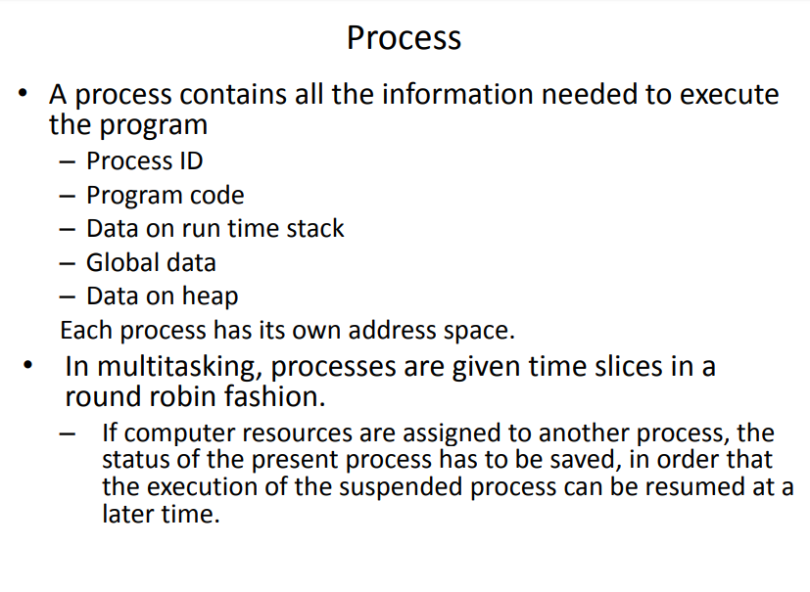

Slide 3
Thread
What is Thread
A process is an instance of a computer program that is being executed. It contains the program code and its current activity.
A thread of execution is the smallest unit of processing that can be scheduled by an operating system.
Differences between threads and processes:
A thread is contained inside a process.
Multiple threads can exist within the same process and share resources such as memory.
The threads of a process share the latter’s instructions (code) and its context (values that
its variables reference at any given moment).
Different processes do not share these resources.
Notes:
https://www3.nd.edu/~zxu2/acms60212-40212-S12/Lec-11-01.pdf
http://en.wikipedia.org/wiki/Process_(computing)

Slide 4
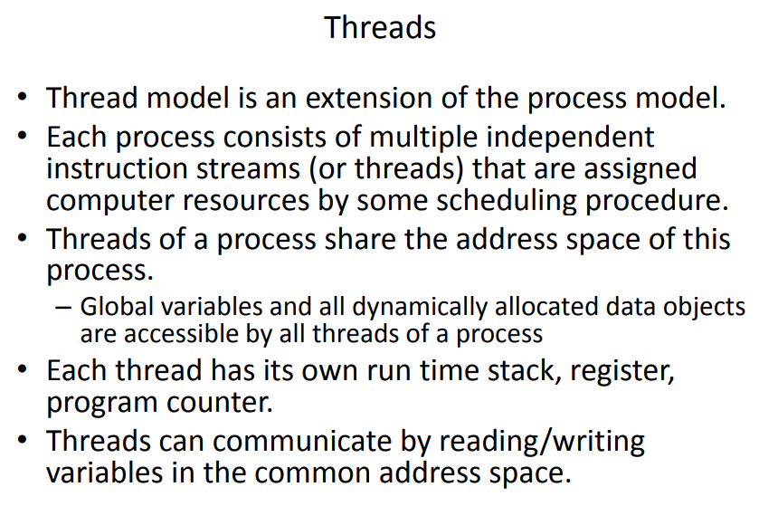

Slide 5
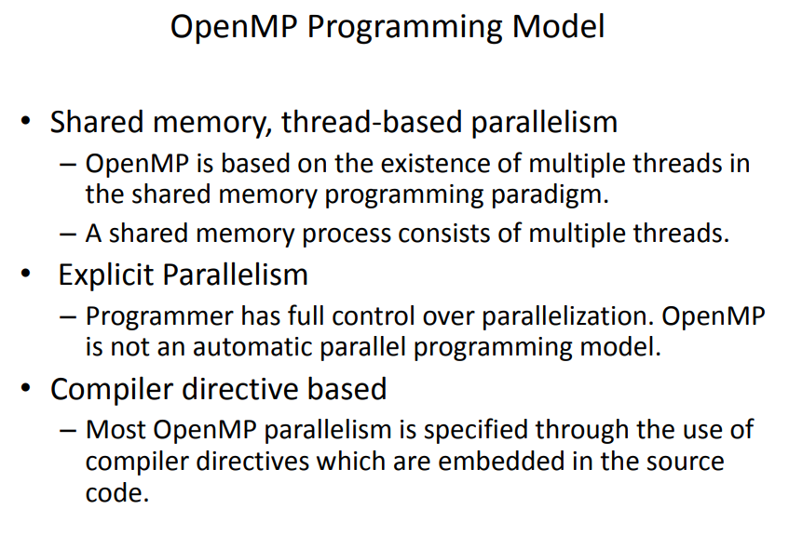

Slide 6
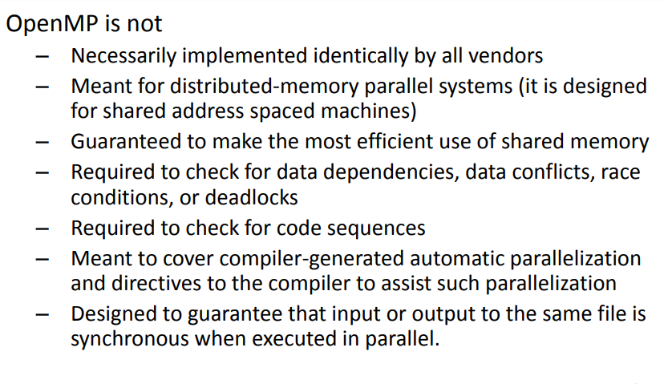

Slide 7
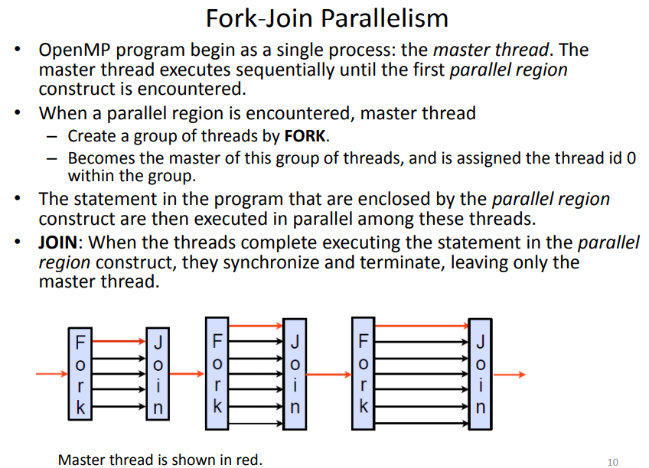

Slide 8
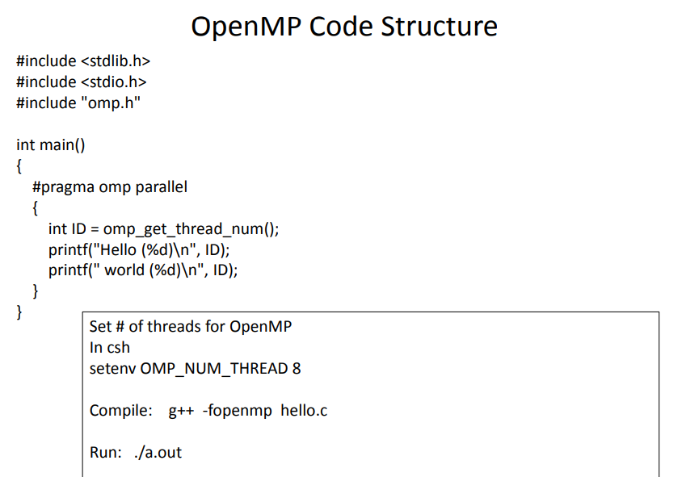

Slide 9
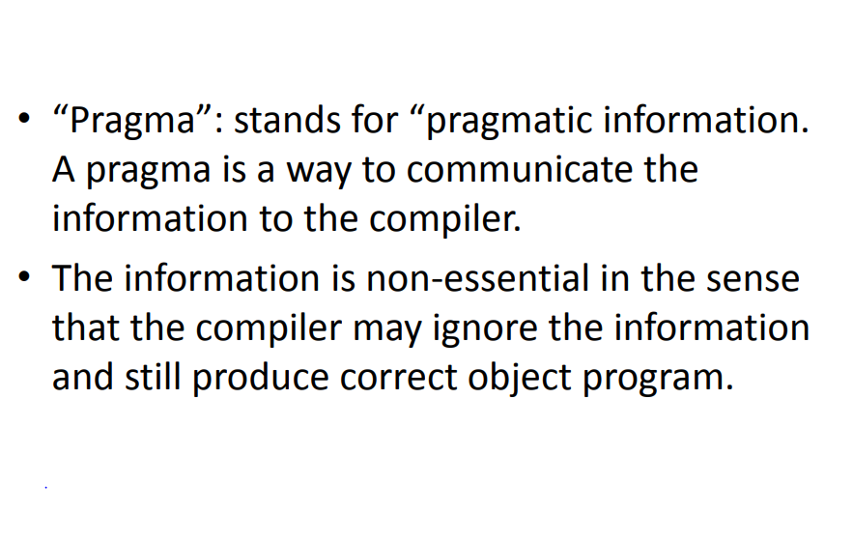

Slide 10
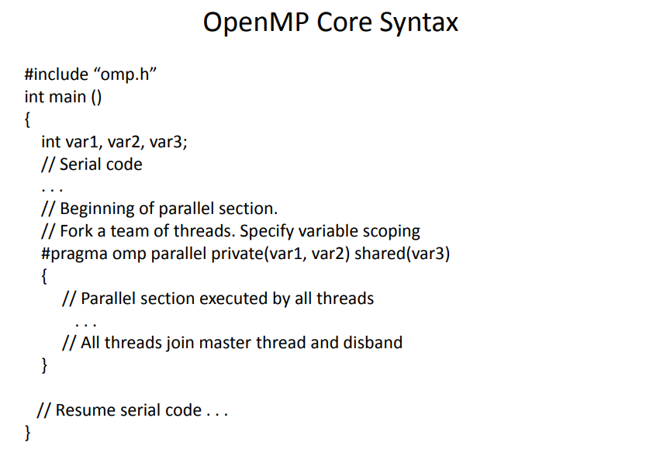

Slide 11
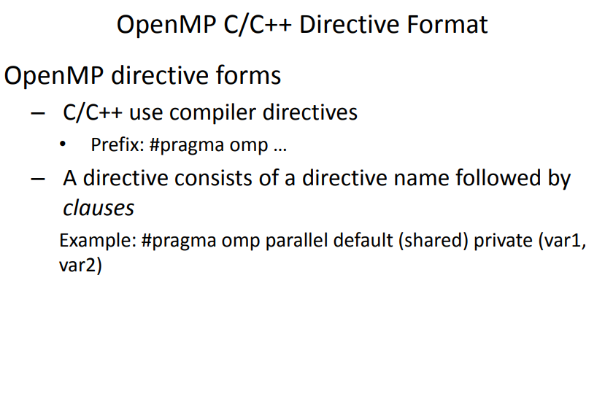

Slide 12
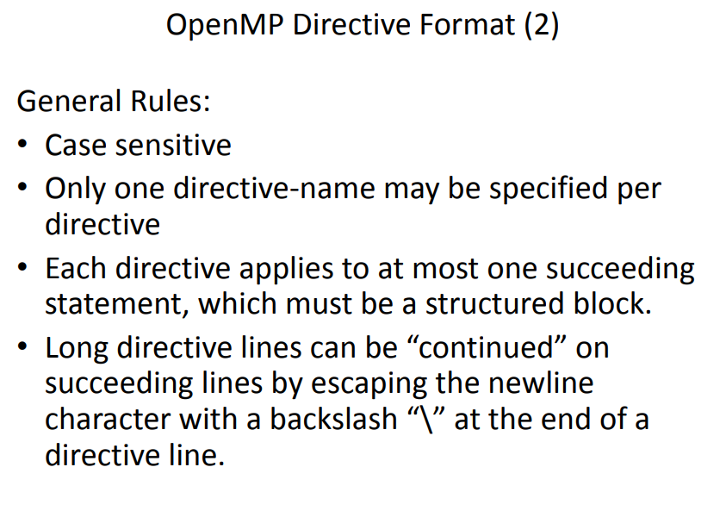

Slide 13
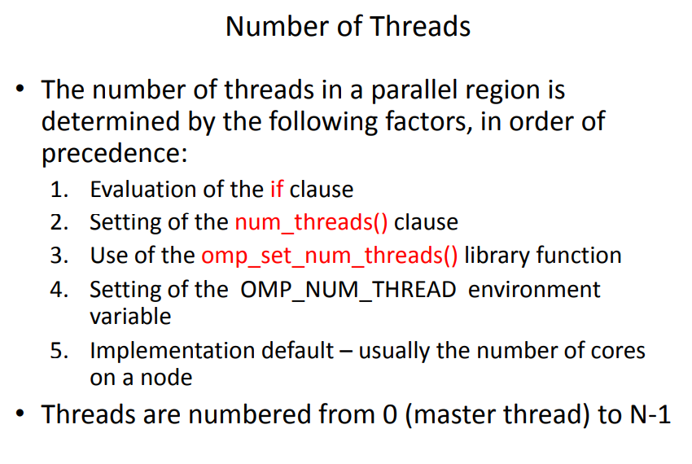

Slide 14
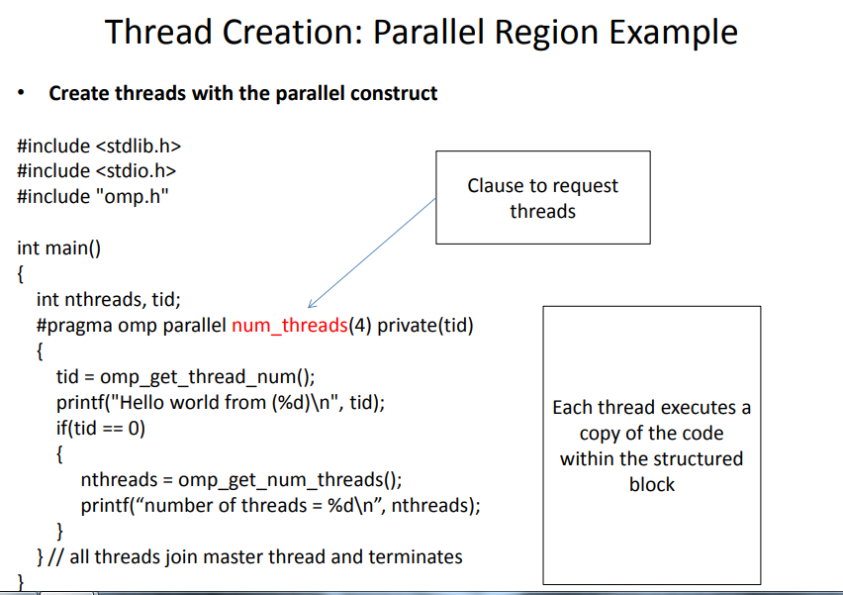

Slide 15
Pros & Cons - OpenMP
Pros of OpenMP-
easier to program and debug than MPI
directives can be added incrementally - gradual parallelization
can still run the program as a serial code
serial code statements usually don't need modification
code is easier to understand and maybe more easily maintained
Incremental parallelism: can work on one part of the program at one time, no dramatic change to code is needed.
Unified code for both serial and parallel applications: OpenMP constructs are treated as comments when sequential compilers are used.
Original (serial) code statements need not, in general, be modified when parallelized with OpenMP. This reduces the chance of inadvertently introducing bugs.
Cons of OpenMP-
can only be run in shared memory computers
requires a compiler that supports OpenMP
mostly used for loop parallelization
High chance of accidentally writing false sharing code.
Notes:
https://www.dartmouth.edu/~rc/classes/intro_mpi/parallel_prog_compare.html
https://en.wikipedia.org/wiki/OpenMP

Slide 16
Performance Expectations
To expect to get a N times speedup when running a program parallelized using an OPENMP on a N processor platform. But its not….rarely it happens as,
When a dependency exists, a process must wait until th data it depends on is computed.
When multiple processes share a non-parallel proof resource (like a file to write in), their requests are executed sequentially. Therefore, each thread must wait until the other thread releases the resource.
A large part of the program may not be parallelized by OpenMP, which means that the theoretical upper limit of speedup is limited.
N processors in a symmetric multiprocessing (SMP) may have N times the computation power, but the memory bandwidth usually does not scale up N times.
Quite often, the original memory path is shared by multiple processors and performance degradation may be observed when they compete for the shared memory bandwidth.
Many other common problems affecting the final speedup in parallel computing also apply to OpenMP, like load balancing and synchronization overhead.
Notes:
https://www.dartmouth.edu/~rc/classes/intro_mpi/parallel_prog_compare.html
https://en.wikipedia.org/wiki/OpenMP

Slide 17
LABORATORY PRACTICE-I (GROUP A)
2. Vector and Matrix Operations-Design parallel algorithm to
1. Add two large vectors
2. Multiply Vector and Matrix
3. Multiply two N × N arrays using n2 processors
3. Parallel Sorting Algorithms-
For Bubble Sort and Merger Sort, based on existing sequential algorithms, design and implement parallel algorithm utilizing all resources available.

Slide 18
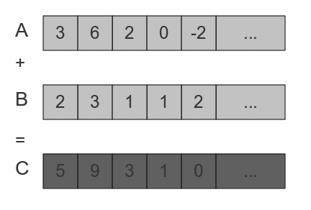
2. Vector and Matrix Operations-Design parallel algorithm to
1. Add two large vectors

Slide 19
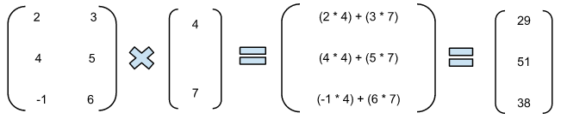
2. Vector and Matrix Operations-Design parallel algorithm to
2.Multiply Vector and Matrix

Slide 20
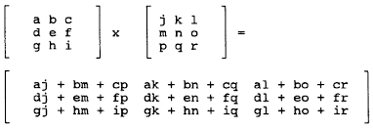
2. Vector and Matrix Operations-Design parallel algorithm to
3.Multiply two N × N arrays using n2 processors

Slide 21
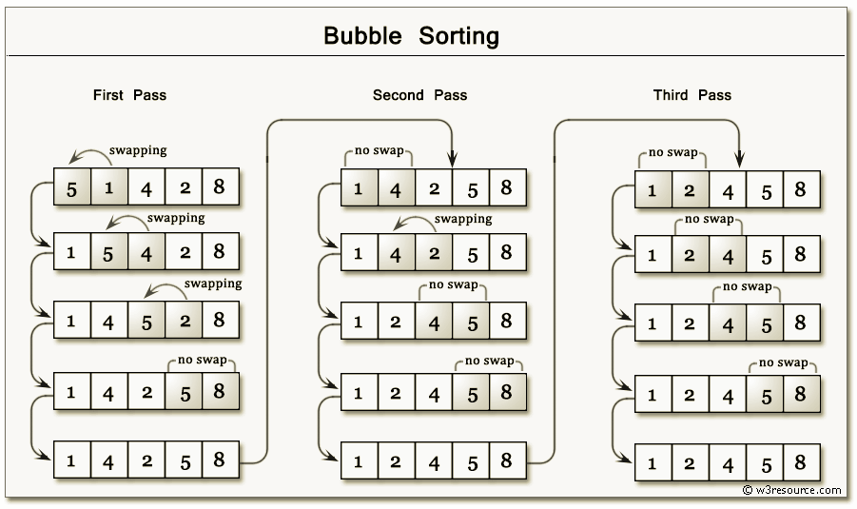
3. Parallel Sorting Algorithms-
For Bubble Sort and Merger Sort, based on existing sequential algorithms, design and implement parallel algorithm utilizing all resources available.

Slide 22
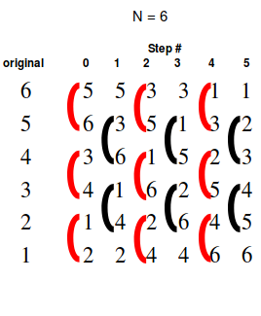
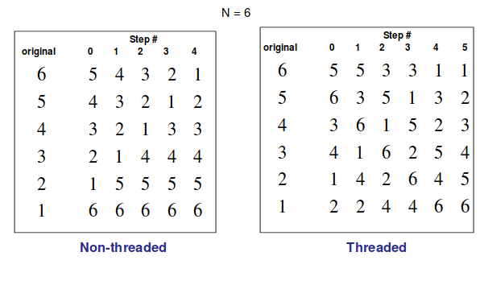
Odd-Even Bubble Sort
This is basically a variation of bubble-sort.
This algorithm is divided into two phases- Odd and Even Phase.
The algorithm runs until the array elements are sorted and in each iteration two phases occurs- Odd and Even Phases.
In the odd phase, we perform a bubble sort on odd indexed elements and in the even phase, we perform a bubble sort on even indexed elements.
Single Pass = One Even Phase + One Odd Phase

Slide 23
Bubble Sort Code:
#include<iostream>
#include<stdlib.h>
#include<omp.h>
using namespace std;
void bubble(int *, int);
void swap(int &, int &);
void bubble(int *a, int n) {
for( int i = 0; i < n; i++ ) {
int first = i % 2;
#pragma omp parallel for shared(a,first) / /Creates parallel threads to swap consecutive elements
for( int j = first; j < n-1; j += 2 ) {
if( a[ j ] > a[ j+1 ] ) {
swap( a[ j ], a[ j+1 ] );
}}}}
void swap(int &a, int &b){
int test; test=a; a=b; b=test; / /swaps two variables
}
int main(){
int *a,n;
cout<<"\n enter total no of elements=>"; cin>>n; a=new int[n];
cout<<"\n enter elements=>"; for(int i=0;i<n;i++) { cin>>a[i]; }
bubble(a,n);
cout<<"\n sorted array is=>"; for(int i=0;i<n;i++) { cout<<a[i]<<endl; }
return 0;}

Slide 24
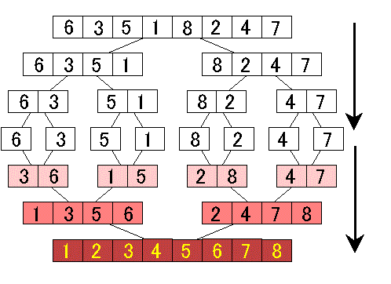
Merge Sort

Slide 25
MERGE SORT:
#include<iostream>
#include<stdlib.h>
#include<omp.h>
using namespace std;
void mergesort(int a[],int i,int j);
void merge(int a[],int i1,int j1,int i2,int j2);
void mergesort(int a[],int i,int j){
int mid; if(i<j) {
mid=(i+j)/2;
#pragma omp parallel sections { / /implements both left and right sections in parallel
#pragma omp section { mergesort(a,i,mid); } / /parallelized left section
#pragma omp section { mergesort(a,mid+1,j); } / /parallelized right section
}
merge(a,i,mid,mid+1,j); }} / /merge function outside parallel section to sort
void merge(int a[],int i1,int j1,int i2,int j2){
int temp[1000]; int i,j,k; i=i1; j=i2; k=0;
while(i<=j1 && j<=j2) {
if(a[i]<a[j]) { temp[k++]=a[i++]; } / /copying lowest element from left or right subarray to temp array
else { temp[k++]=a[j++]; } }
while(i<=j1) { temp[k++]=a[i++]; } / /copying remaining elements from left subarray
while(j<=j2) { temp[k++]=a[j++]; } / /copying remaining elements from left subarray
for(i=i1,j=0;i<=j2;i++,j++) { a[i]=temp[j]; } }
int main(){ int *a,n,i;
cout<<"\n enter total no of elements=>"; cin>>n; a= new int[n];
cout<<"\n enter elements=>"; for(i=0;i<n;i++) { cin>>a[i]; }
mergesort(a, 0, n-1);
cout<<"\n sorted array is=>"; for(i=0;i<n;i++) { cout<<"\n"<<a[i]; } return 0;}

